Slide 1

DATA SCIENCE INTERNSHIP PROJECT ON CUSTOMER SEGMENTATION
PRESENTED BY
NDIBE IFEOMA M

Slide 2
PROJECT OVERVIEW:
The project aims to identify meaningful customer segments that will empower businesses to customize their offerings, improve customer engagement, and drive targeted marketing campaigns for more impactful results.

Slide 3
PROJECT OBJECTIVES:
The Customer Segmentation project is to leverage advanced analytics and machine learning techniques in line with the business objectives:
Classify and group customers based on their behavior, preferences, and characteristics,
Tailor the recommendations to specific customer segments, optimizing marketing efforts,
Enhancing customer satisfaction, and ultimately maximizing overall business performance.
Foster stronger customer relationships.

Slide 4
Data Dictionary:
1. Category: The category of the purchased item (e.g., Health & Sports, Men's Fashion, Computing, Entertainment, Mobiles & Tablets).
2. City: The city where the customer resides.
3. County: The county where the customer resides.
4. Cust Id: Unique identifier for each customer.
5. Customer Since: The date when the customer started their association with the company.
6. Date of Order: The date when the order was placed.
7. Full Name: The full name of the customer.
8. Gender: The gender of the customer.
9. Item Id: Unique identifier for each item.
10. Order Id: Unique identifier for each order.

Slide 5
Data Dictionary continued:
10. Order Id: Unique identifier for each order.
11. Payment Method: The method used by the customer to make the payment (e.g., Easypay_MA, Payaxis).
12. Place Name: The name of the place where the order was placed.
13. Ref Num: Reference number associated with the order.
14. Region: The region where the order was placed.
15. State: The state where the customer resides.
16. User Name: The username associated with the customer.
17. Zip: The ZIP code of the customer's location.
18. Qty Ordered: The quantity of the ordered item.
19. Total: The total amount spent on the order.

Slide 6
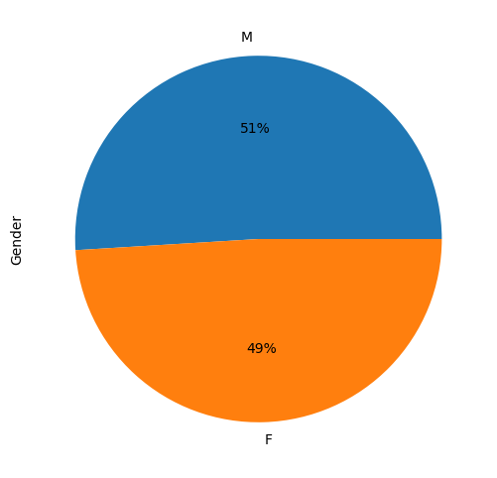
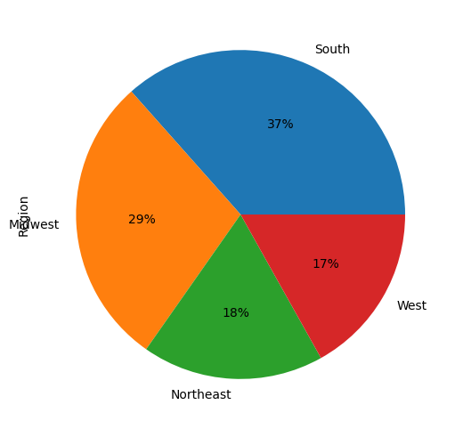
DATA VISUALIZATION: UNIVARIATE ANALYSIS PIE CHART ON GENDER PIE CHART BY REGION

Slide 7
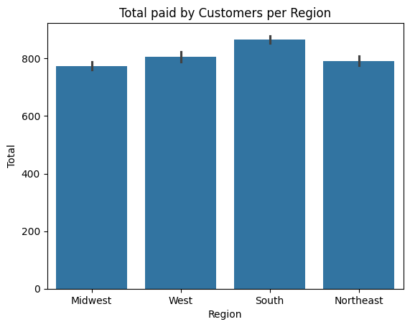
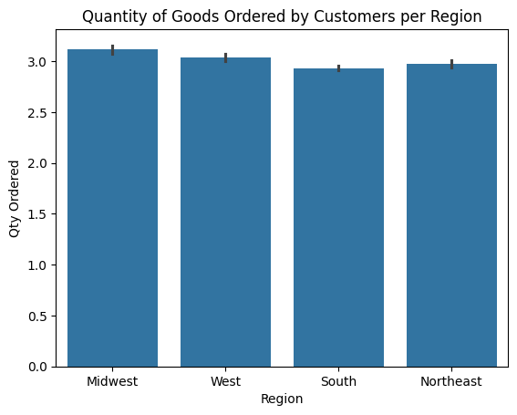

Slide 8
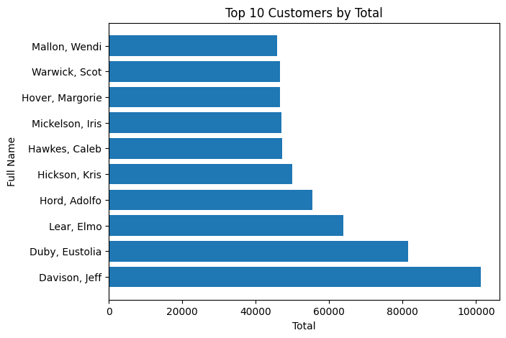
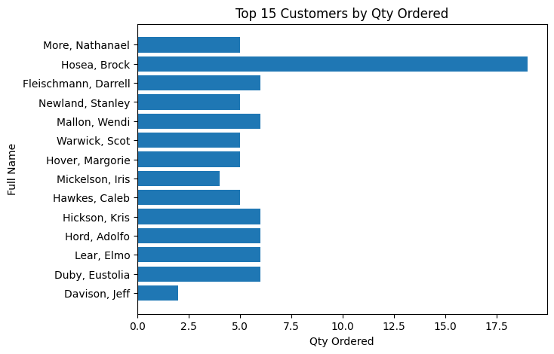

Slide 9
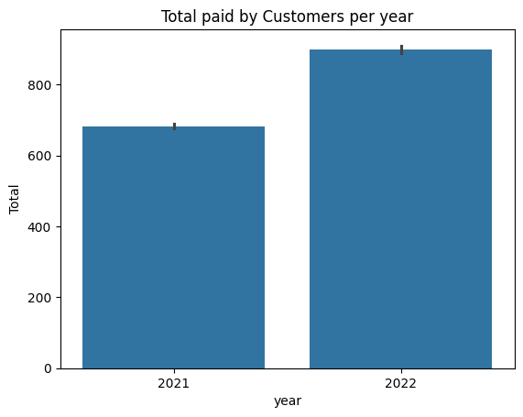
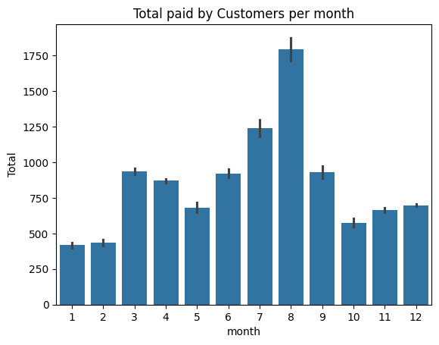

Slide 10
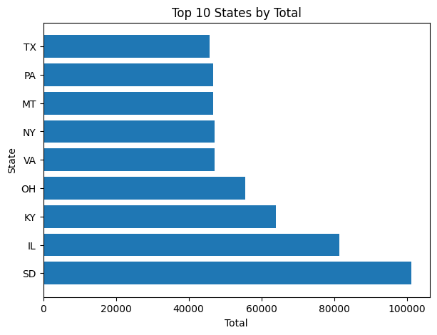

Slide 11
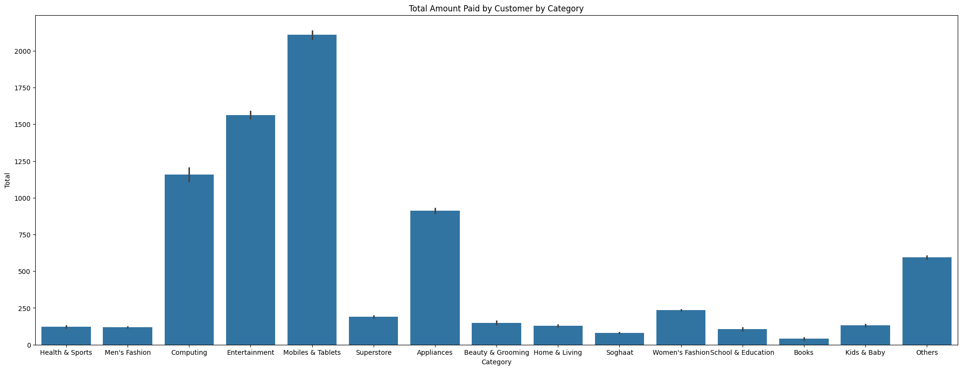
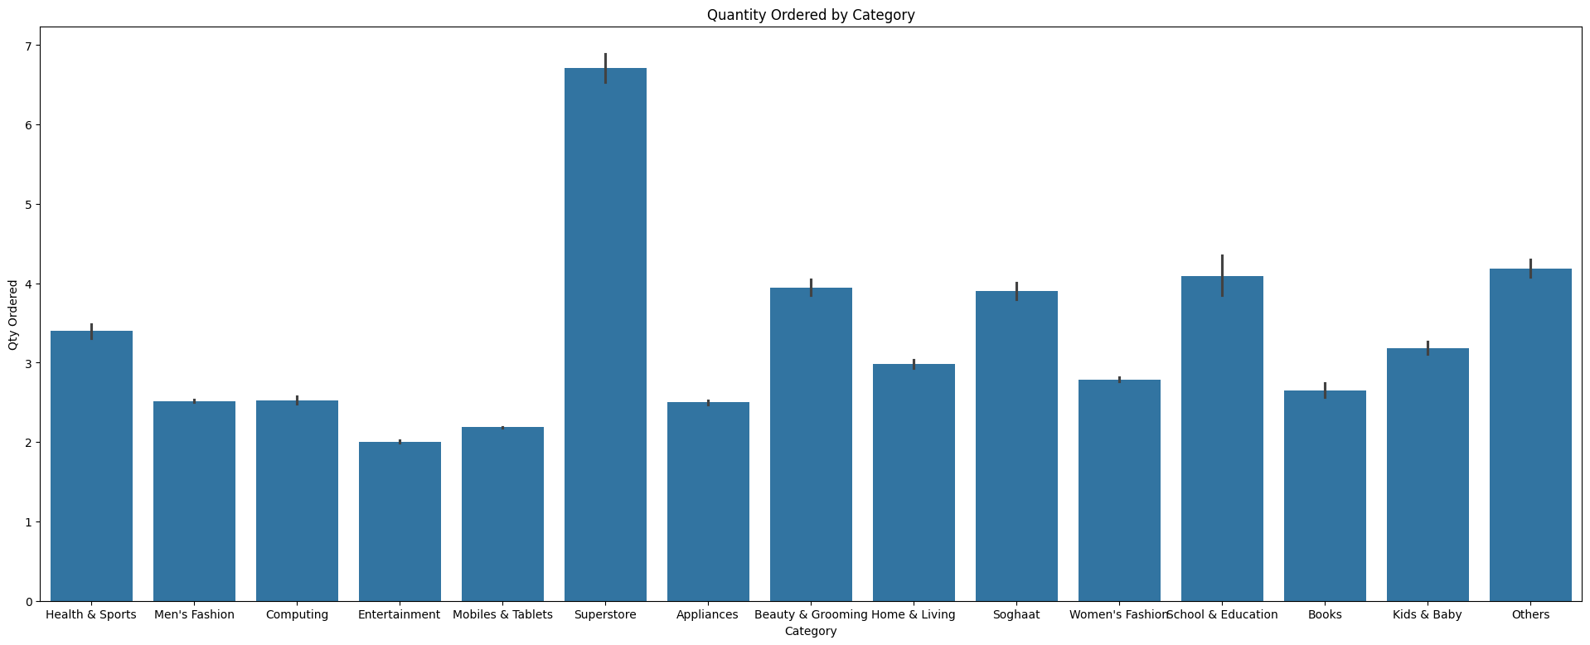

Slide 12
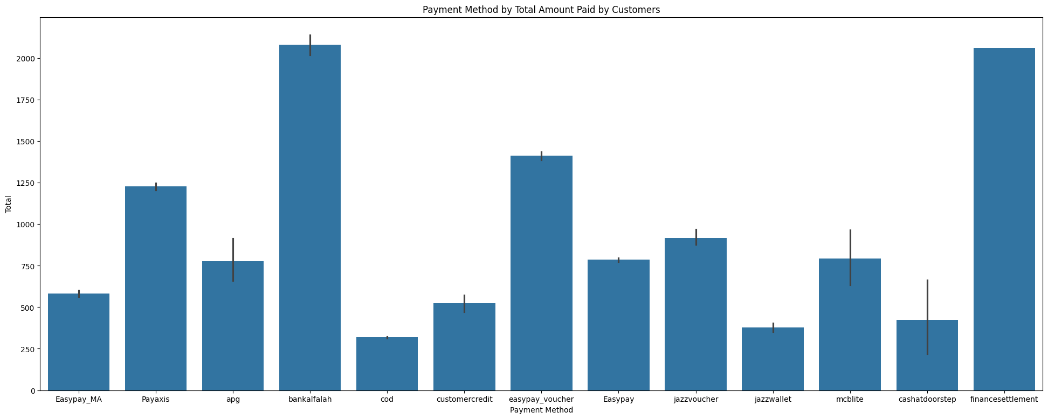
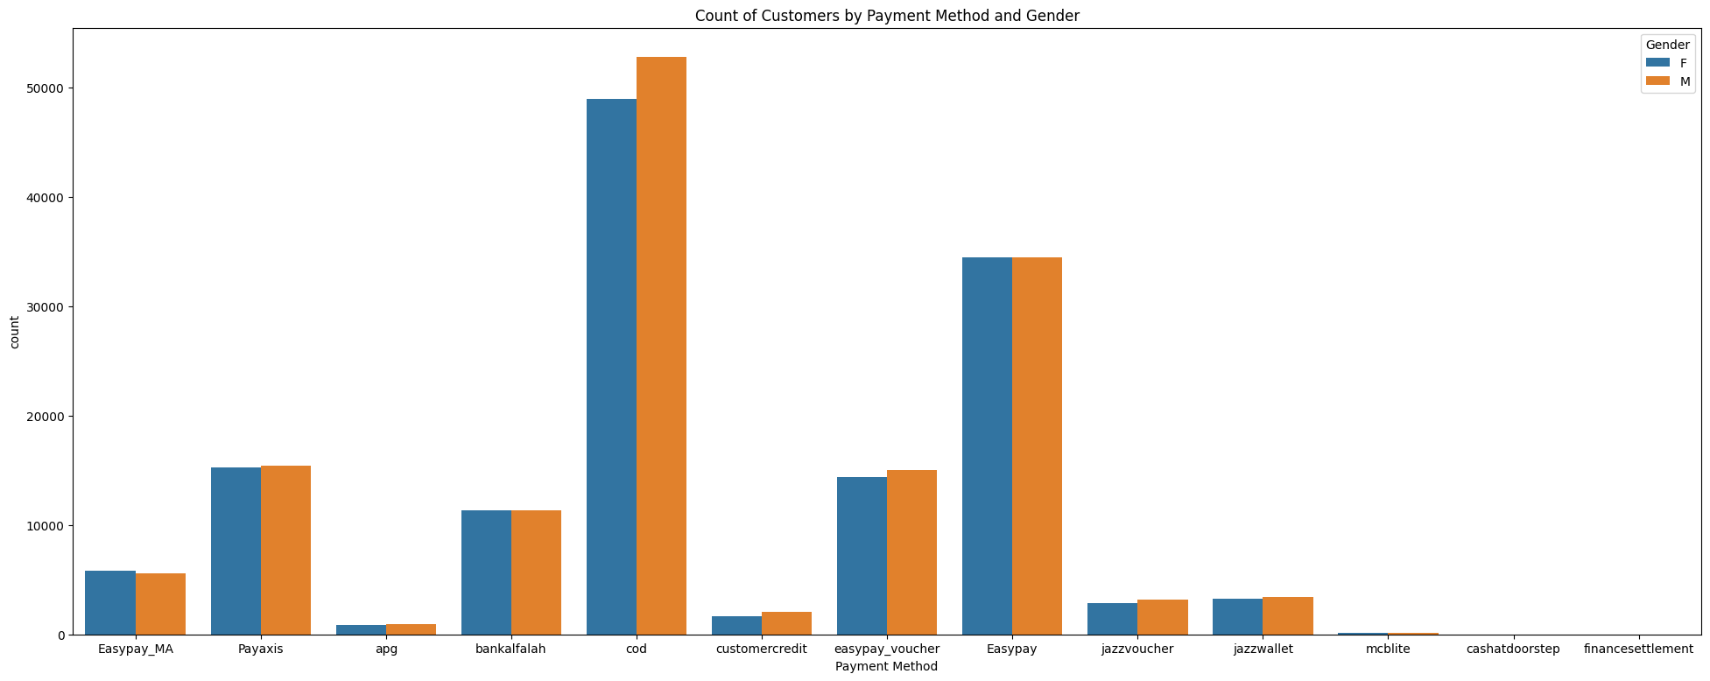
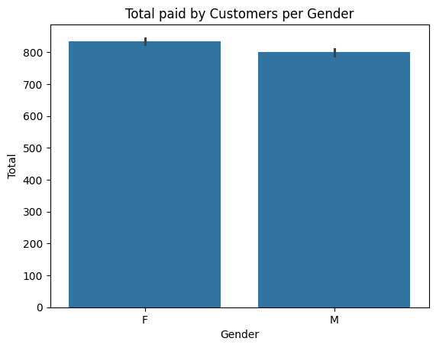

Slide 13
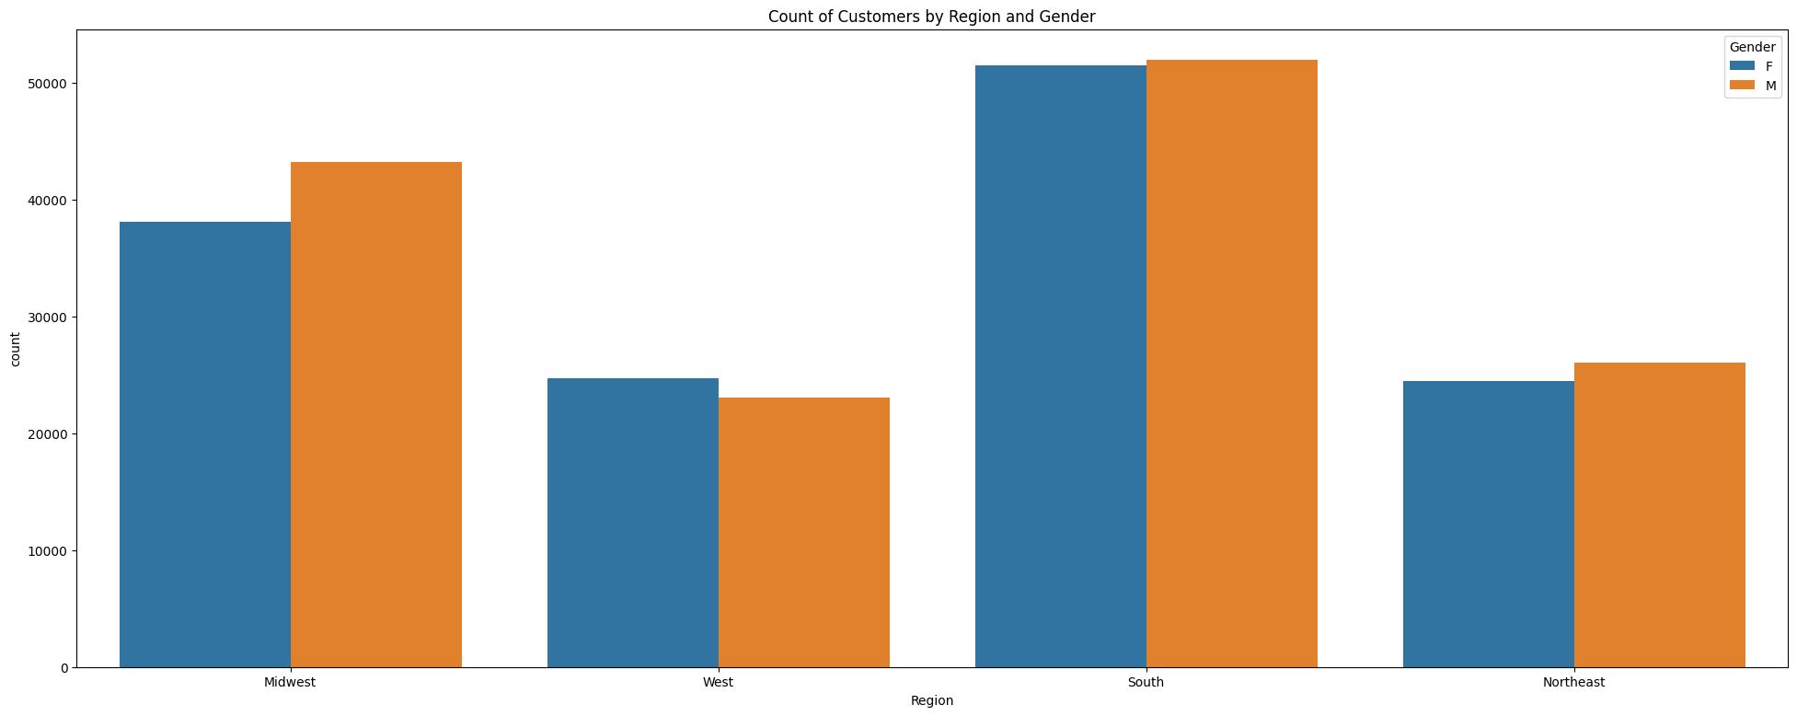
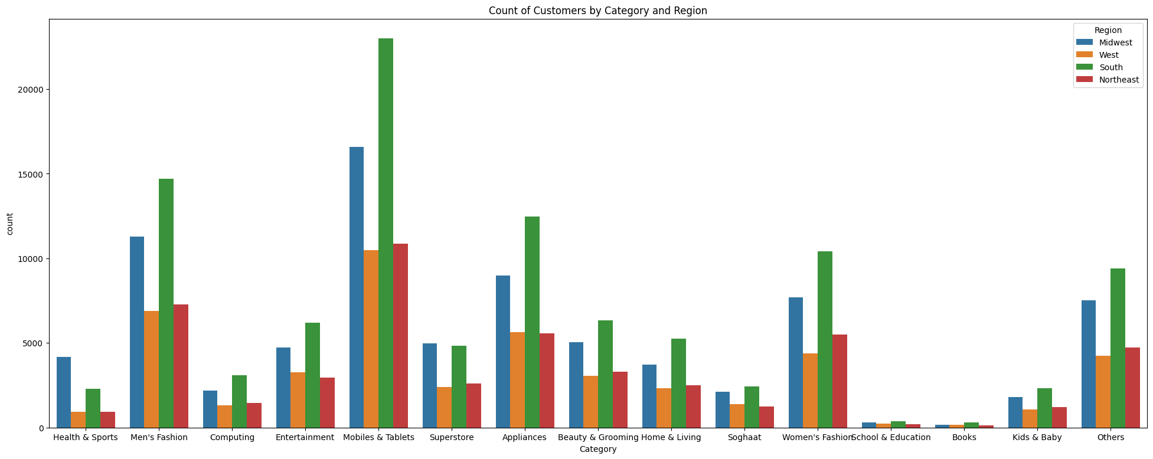

Slide 14
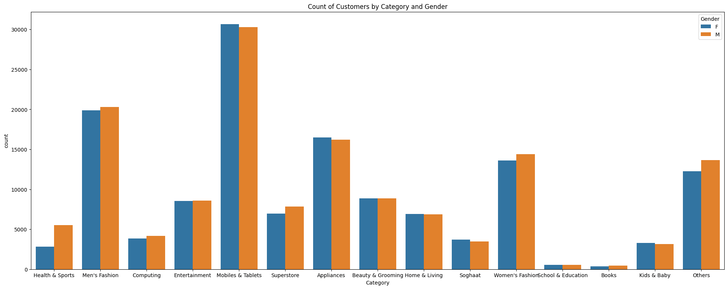
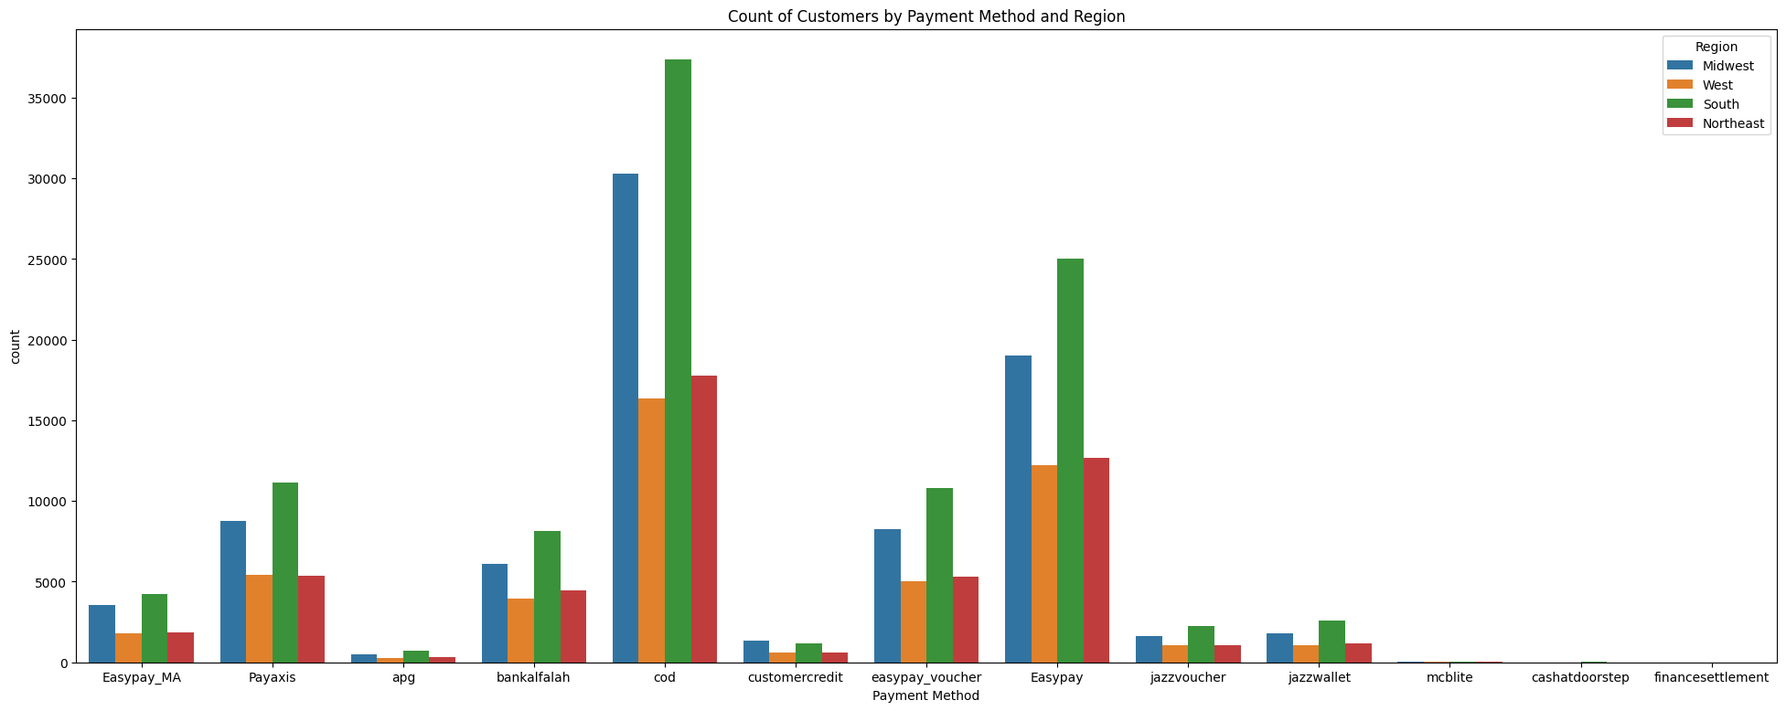

Slide 15
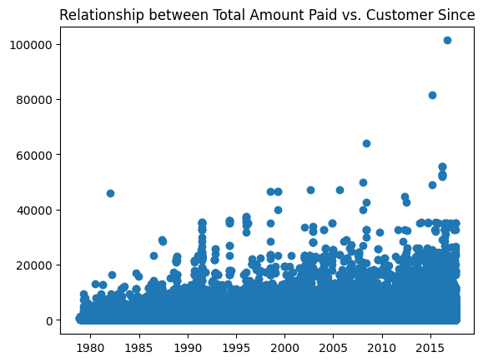
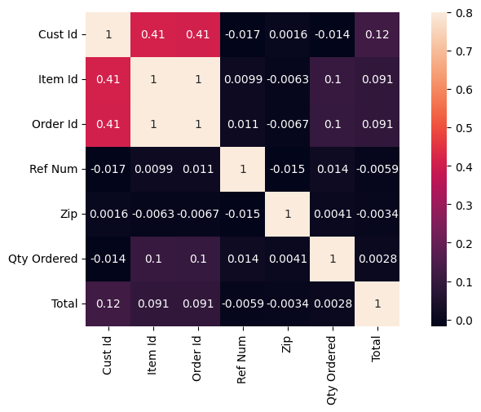
MULTIVARIATE ANALYSIS CHECKING FOR CORRELATION BETWEEN THE LENGTH OF TIME A CUSTOMER HAS BEEN WITH STERLING AND THEIR SPENDING SCATTERPLOT HEATMAP

Slide 16
Recency, Frequency, Monetary (RFM) Analysis:
Create new columns: Recency, Frequency, and Monetary value to understand customer behavior.
Recency (R): This calculates how recently a customer has engaged with the business.
Recency = Date of Order - Customer Since
Customers who have engaged recently might be more valuable for optimizing marketing efforts and drive targeted market campaigns.
Frequency (F): This calculates how often a customer interacts with the business.
This is calculated as the total number of transactions over a specific period.
Frequency = Number of unique order per customer
High-frequent customers are those who engage with the business more frequently.
Monetary (M): This measures the monetary value of a customer's transactions.
This is calculated as the total amount of money spent by the customer.
Monetary Value = Sum total amount paid by customers.
A High monetary value reveals customers who contribute most significantly to the business's revenue.

Slide 17
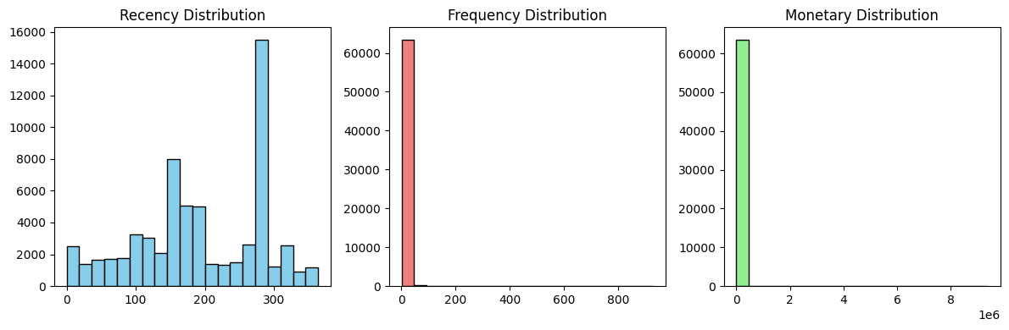
RFM Distribution.

Slide 18
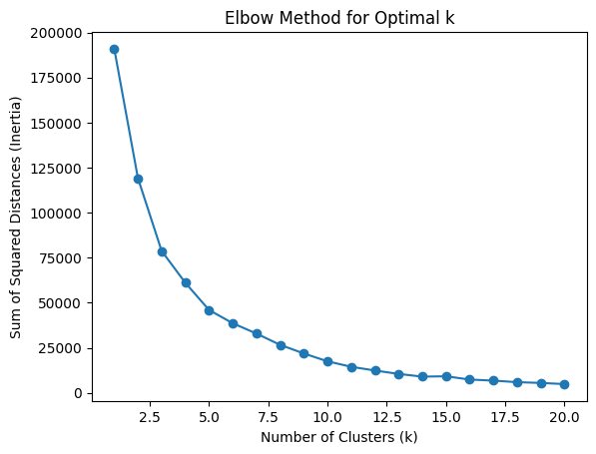
MACHINE LEARNING K-MEANS & Standard Scaler.

Slide 19
ANOTHER MACHINE LEARNING METHOD USED: ONE HOT ENCOCODING: One-Hot Encoding (OHE): In this method, a binary vector is created for each categorical variable. An Alternative to K means is DBSCAN. DBSCAN is an excellent choice when you want to identify clusters in your data based on the density of data points in a specific region. In contrast to K-means, DBSCAN doesn't require you to specify the number of clusters in advance. Instead, it forms clusters based on the density of the data points. You can use DBSCAN in scenarios where the number of clusters is unknown or potentially variable, and the data may not follow a circular pattern. It's also suitable for dealing with noise and outliers in the data. Here's an alternative approach using the DBSCAN algorithm:

Slide 20
Evaluate the Model performance.
Mean Squared Error: 0.009985553011374656
Root Mean Squared Error: 0.09992773894857551
R2 Score: 0.9901130839453041
MSE= 99%
RMSE =99%
R2 Score= 99%
This is a high score, indicating a very strong correlation between the
predicted values and the true values.
This means that the model is very accurate and capable of predicting
the values of the features with a high degree of accuracy.

Slide 21
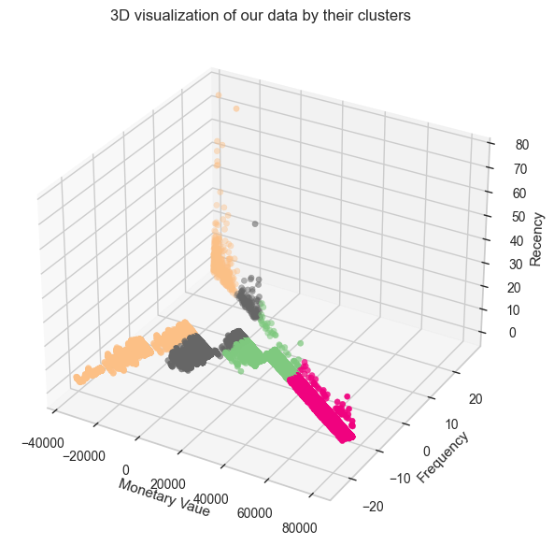
PCA. EXPLAINED_VARIANCE_RATIO_
The array [9.99999981e-01, 1.42405766e-08, 2.25976970e-09] for explained_variance_ratio_ .
1st PCA = 99.99998 approximately 100%,
PCA suggests that the first principal component explains almost all of the variance in the data, while the second and third components contribute very little.

Slide 22
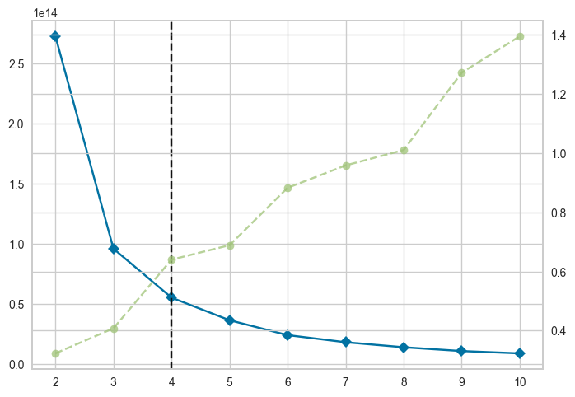
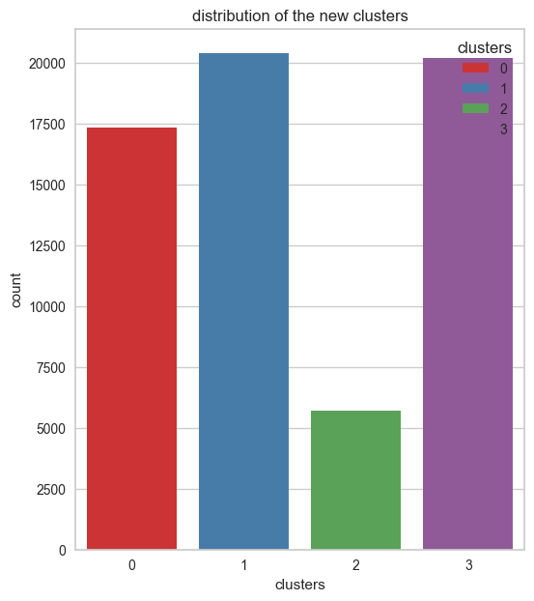
Using the K-Elbow method to figure /determine the appropriate number of clusters
K= Number of clusters=4

Slide 23
Silhouette Score for 4 clusters: 1.0 Interpretation:
The perfect silhouette score 1, suggests that the choice of 4 clusters is highly appropriate for your data.
I performed a Numpy Log Transformation.
To Normalize the data.

Slide 24
Loyal Customers – 35,378
ii. Champions – 27,968
iii. At Risk – 289
iv. Lost Customers - 11

Slide 25
FINDINGS & RECOMMENDATIONS:
35,398 are Loyal Customers: These set of customers made recent high-value purchases and are loyal to the business.
Maintain communication, provide loyalty rewards with exclusive discounts, loyalty programs and offer incentives to increase spending.
Request feedback and involve them in decision making process to make them feel valued.
27,968 are Champions: These are valuable customers who recently made high-value purchases frequently.
Reward their loyalty, encourage continued engagement and offer exclusive deals.

Slide 26
FINDINGS & RECOMMENDATIONS continued
289 Customers at risk:
Identify and address any issues or concerns these customers may have.
Provide exclusive offers or loyalty programs to retain their interest
11 Lost Customers: Unfortunately these customer are lost.
They have been inactive for a long period of time.
Consider targeted win back campaigns and survey to understand the reasons for their departure.
Use insights gained and incentives to improve customer satisfaction and retention strategies for other customers.

Slide 27
THANK YOU.

